Slide 1
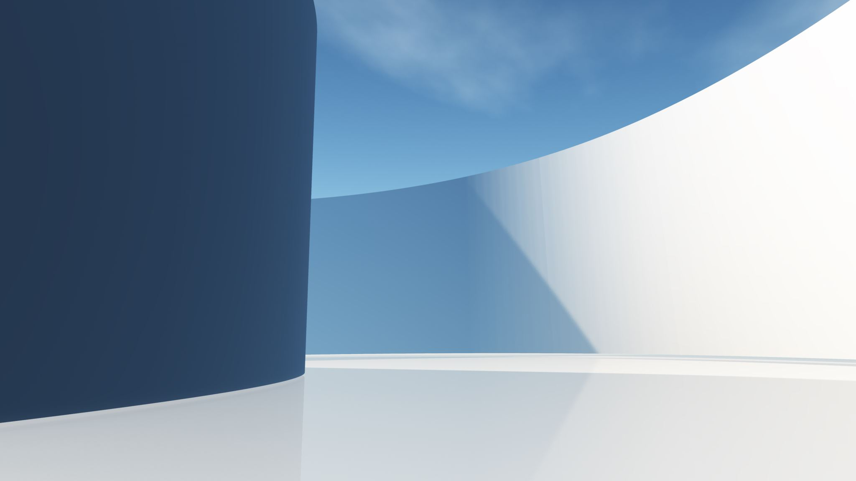
Hydroelectric Digital Twin
Alea Minar 5/1/2025

Slide 2
Digital Twin Model for PNNL
Goal:
Teach elementary and middle school students about digital twins and hydroelectric energy
The Project:
Create a 3D model and digital twin of a hydroelectric generator

Slide 3

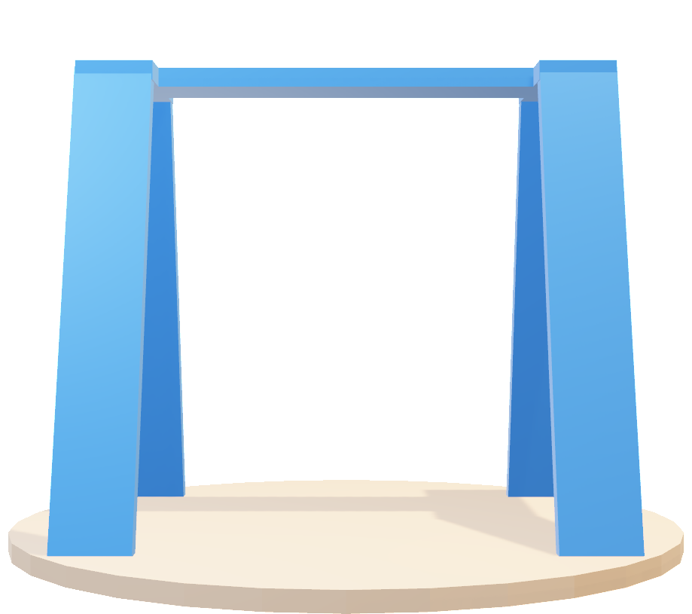
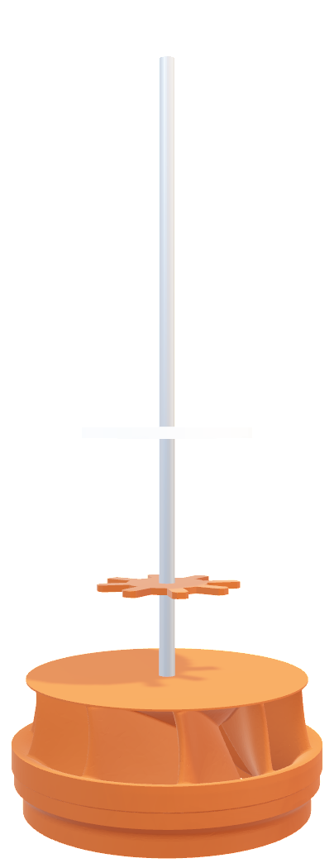
3D Model (Blender)
Hydroelectric turbine and generator
Spinnable by students
Digital twin with equivalent RPM
Notes:
The model consists of a stand, a turbine, a generator, and a gear which will be spun by students. Then the digital twin will spin with the same RPM. Here you can see the 3D model I made in Blender of the entire project.

Slide 4
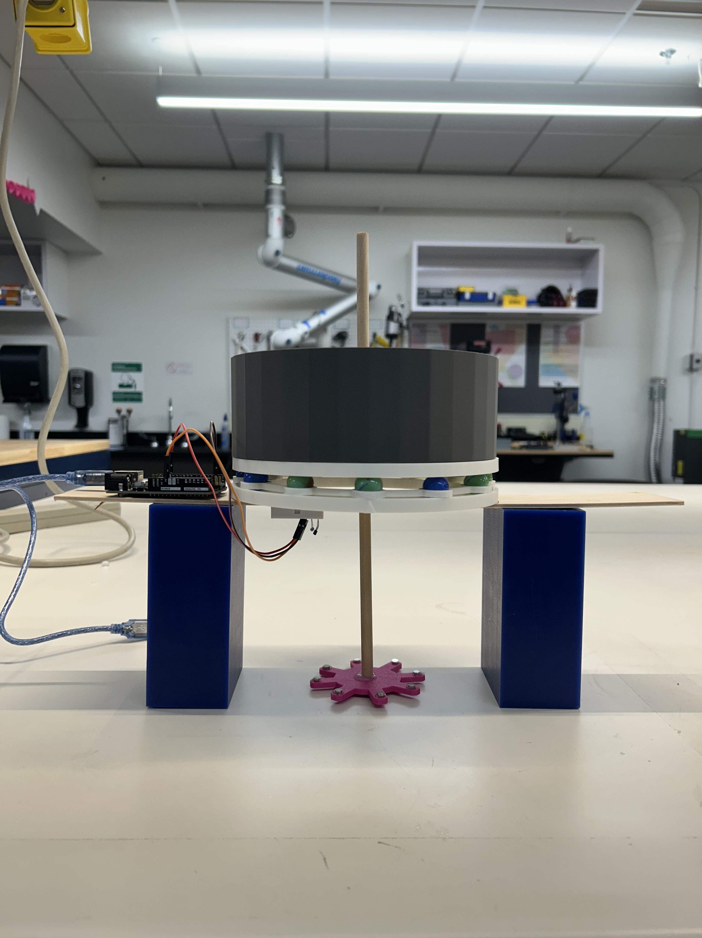
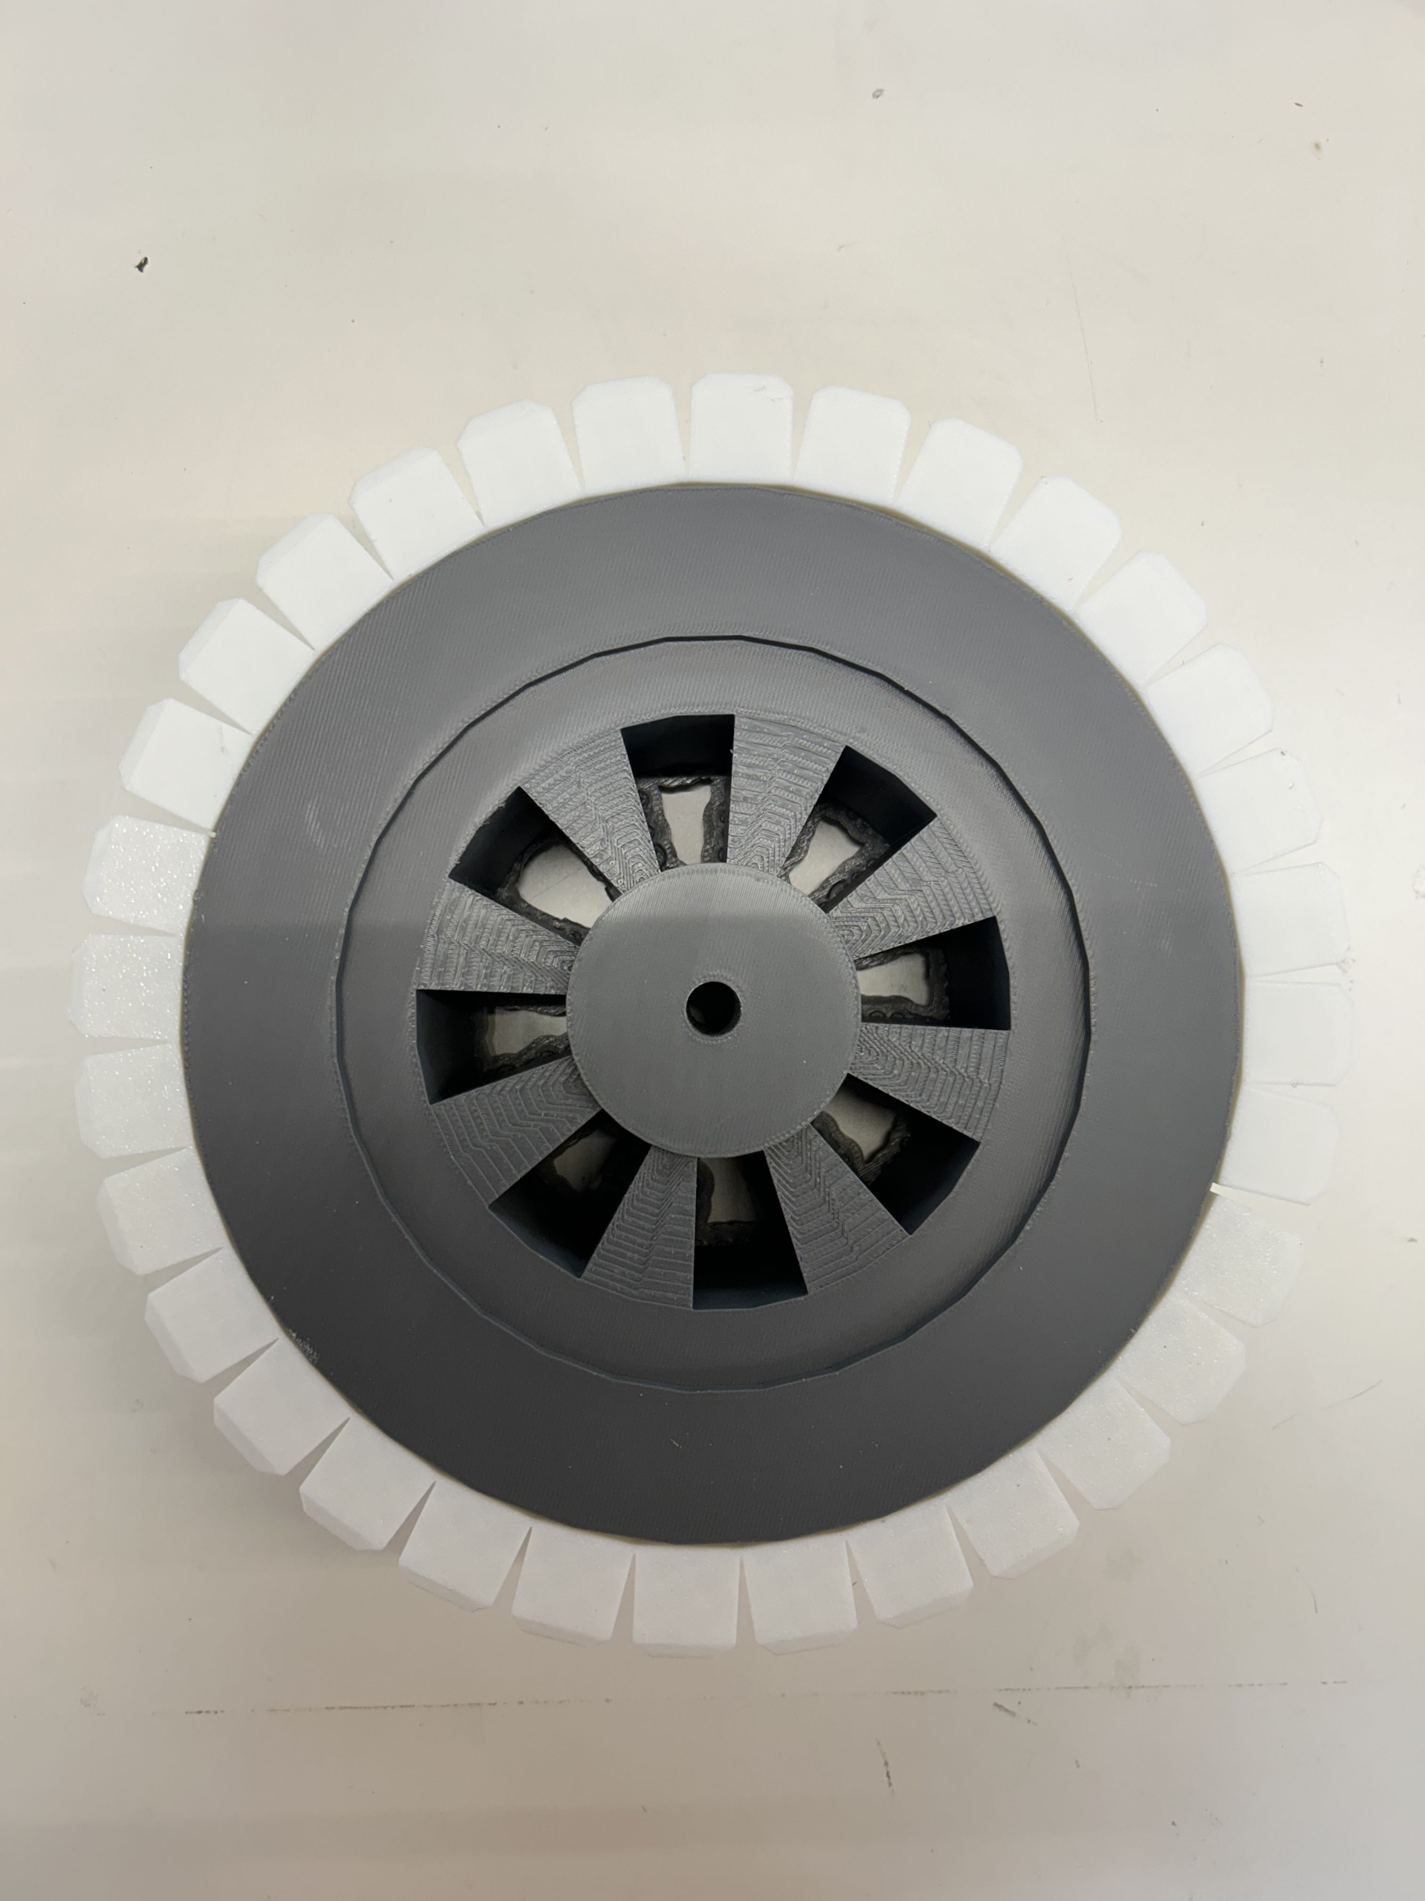
3D Printed Model
Test setup with Arduino
Generator model with support, yoke, and magnetic poles
Notes:
Once the models were finished, I moved onto bringing them to life. I 3D printed the generator, gear, and turn table. Because the stand and turbine were at PNNL, I had to make a test setup

Slide 5
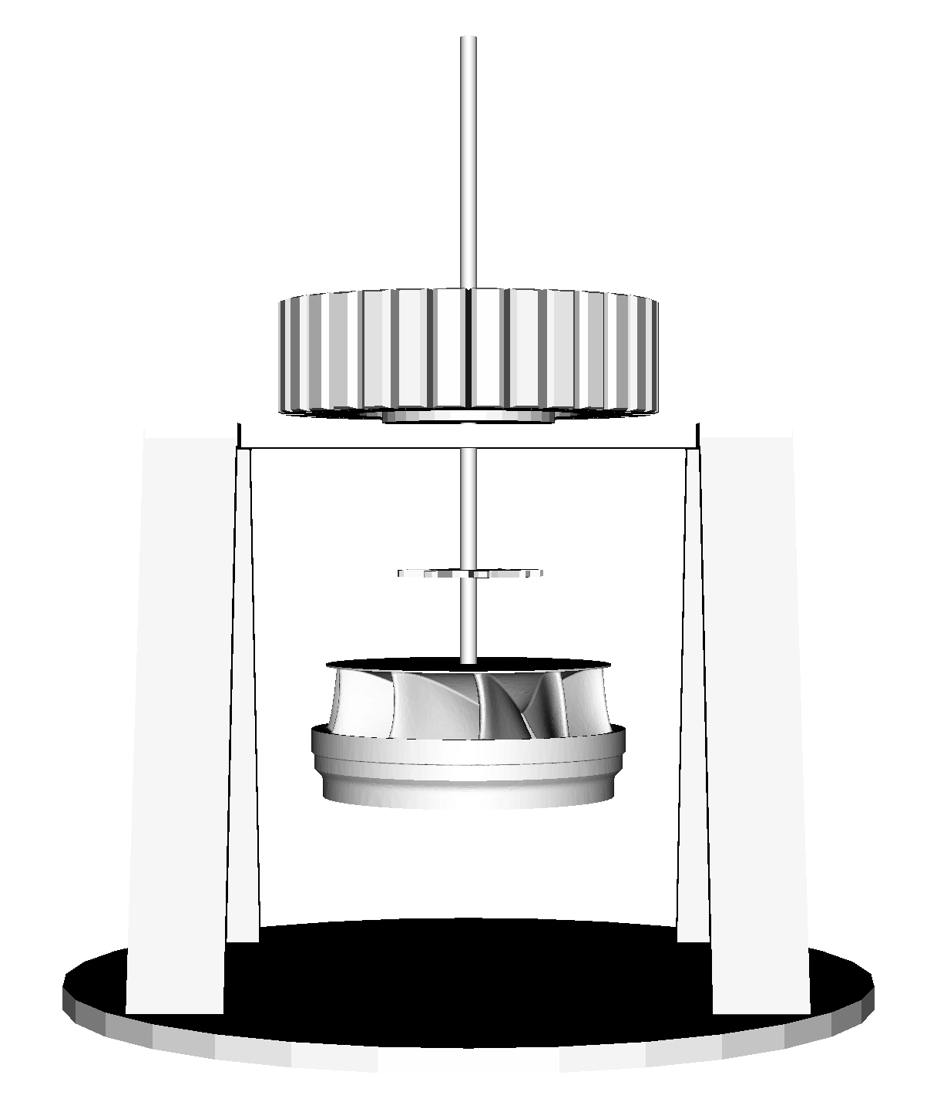
Digital Twin Rendered using Python VTK

Slide 6
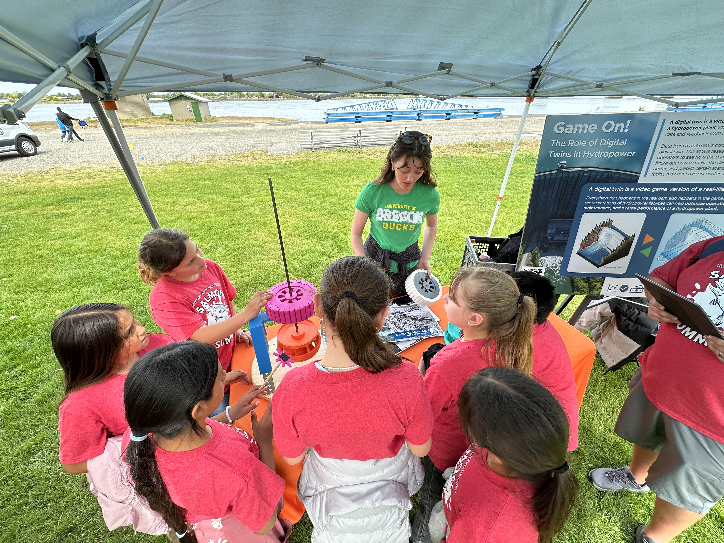
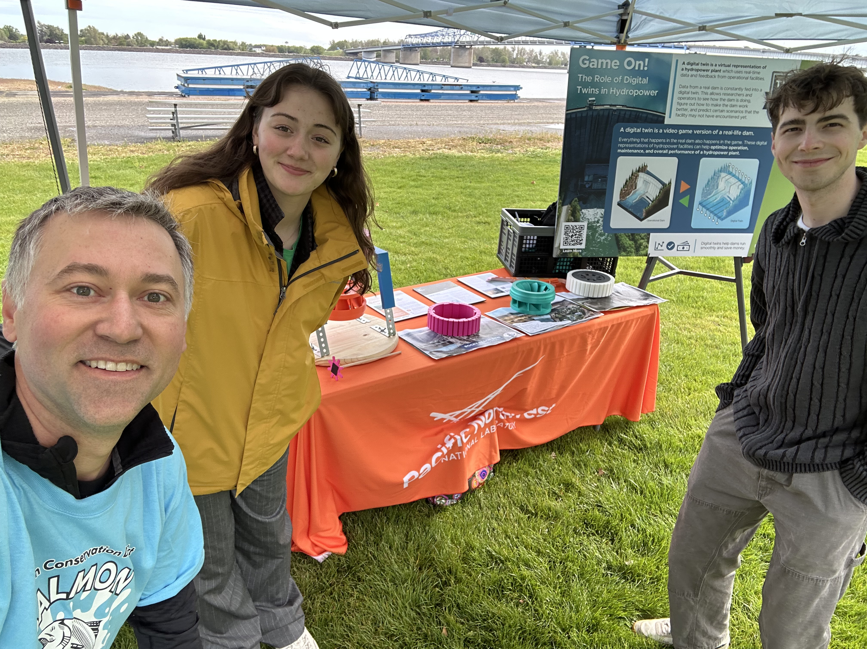
STEM Outreach

